Slide 1





RESUME REVEALER TRACK:
ADVANCED RESUME PARSING CHALLENGE
Sponsors:
Team name: Data Dazzlers
Team members:
Harshaal Bajaj
Hrishita Shah
Kavya Mehta
Ridhdhi Sangani

Slide 2
PROBLEM STATEMENT
Primary Challenge: Develop a comprehensive resume parser, "ResumeRevealer," capable of extracting detailed information from resumes in various formats (PDF, JPG, HTML, DOC, etc.). The parser should accurately classify text into distinct sections (e.g., education, work experience, skills) and sequence them based on dates, where available. ● Standardization Challenge: Enhance the "ResumeRevealer" to standardize different job titles and occupations against the O-NET database, ensuring a consistent taxonomy across parsed resumes. ● Skill Extraction Challenge: Implement an advanced feature in "ResumeRevealer" that mines detailed skills and competencies from project descriptions and position roles within the resume, highlighting the candidate's specific abilities and expertise. Abstractive skill extraction is a bonus.

Slide 3
INTRODUCTION
In this project, our aim was to create a resume parser which will take into input a resume and help us in extracting the crucial information like the name, skills, education and experience of the applicant. We use different python libraries and import modules to perform the tasks. This is a very useful project because it allows us to reduce manual labour as we allow technology to make our task easier. This project will be mainly used by recruiters and hiring managers.

Slide 4
OUR PROPOSED APPROACH
We have used NLP to a great extent in this approach. 1) Text extraction: We have extracted text from resumes of different file formats like pdf, docx or txt 2) Job title extraction: The extracted text data is processed to identify and extract job title from resume 3) Preprocessing: This involves converting text to lowercase, removing punctuation and tokenization. 4) Word Embedding: It means using the Word2Vec model. 5) Cosine similarity matching: After the Word2Vec is performed, we perform cosine similarity between the job titles that we extract and the job title list. 6) Mapping with Threshold: If the cosine similarity is greater than the threshold defined, then we map the extracted job title to the predefined title. 7)Storage and output: The txt file of the skills is generated and the final extracted job title is generated as the output

Slide 5
WHY SHOULD ONE USE THIS MODEL
This is a very useful model because we are using technology at a new level which helps us in saving time and human effort. Here, we are training a model to extract skills, education and experience which is highly useful when it comes to the reducing the work load on recruiters and hiring managers. This model can help them to shortlist their resumes according to the skills they require the most in any applicant.

Slide 6
LIMITATIONS OF THIS MODEL
Text extraction from different file formats is accurate in most cases but may fail sometimes.
Mapping of job titles to the O-NET fails in some cases.
Sectional bifurcation may not work well at times.
Certain job titles may not be available in the predefined vocabulary and that might lead to uncertain results.

Slide 7
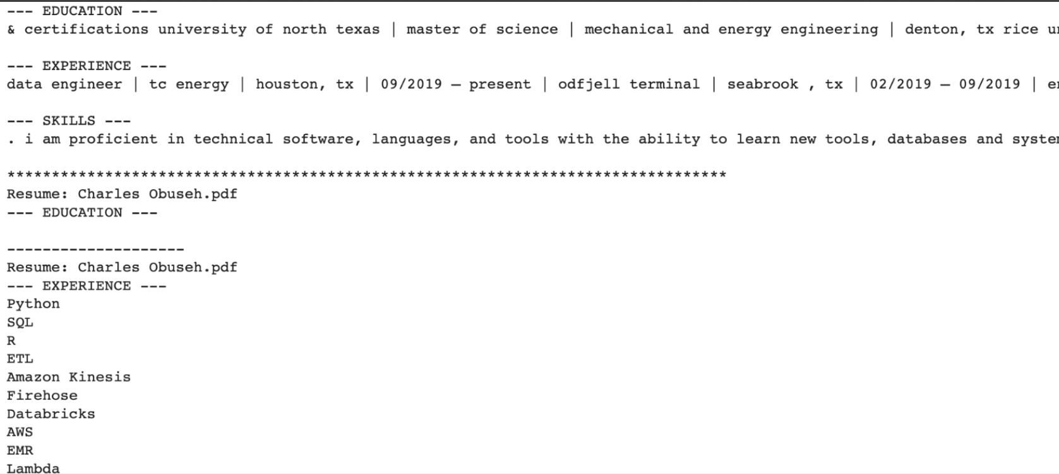
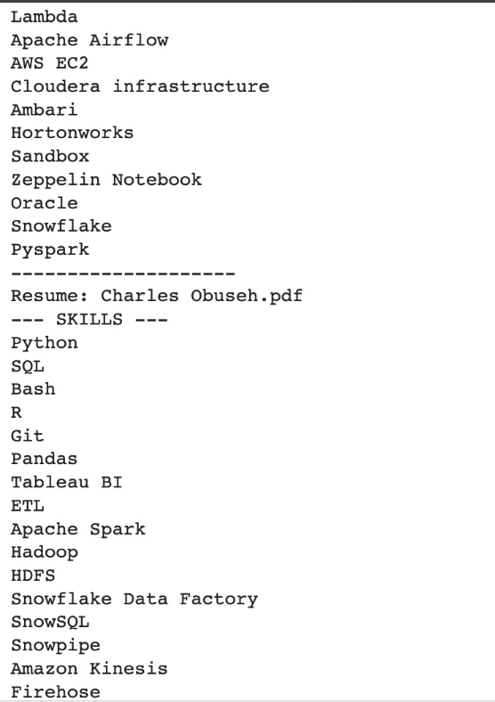
SCREENSHOT OF THE OUTPUT

Slide 8
REFERENCES
https://huggingface.co/Kiet/autotrain-resume_parser-1159242747
https://www.open-resume.com/resume-parser
https://www.onetcenter.org/taxonomy/2019/list.html

